Slide 1
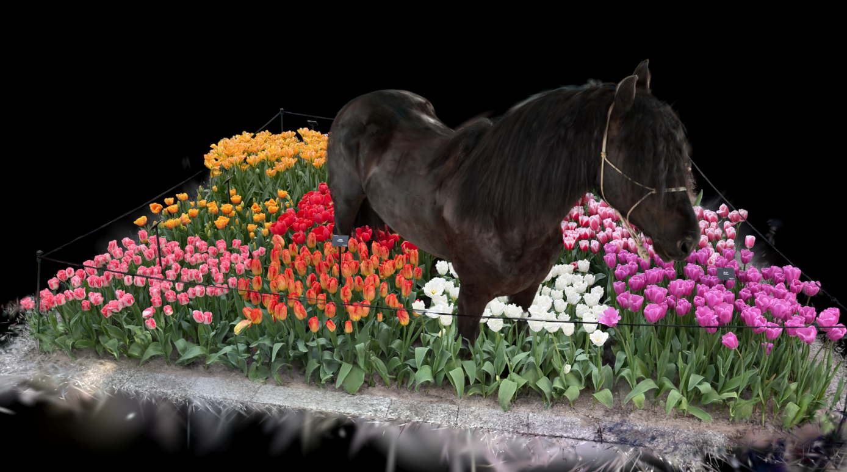
Unity Gaussian Splatting Toolkit

Slide 2
Names
Team
Kaleb Wells – wells2kb@mail.uc.edu
Advisor
Dr. Jillian Aurisano

Slide 3
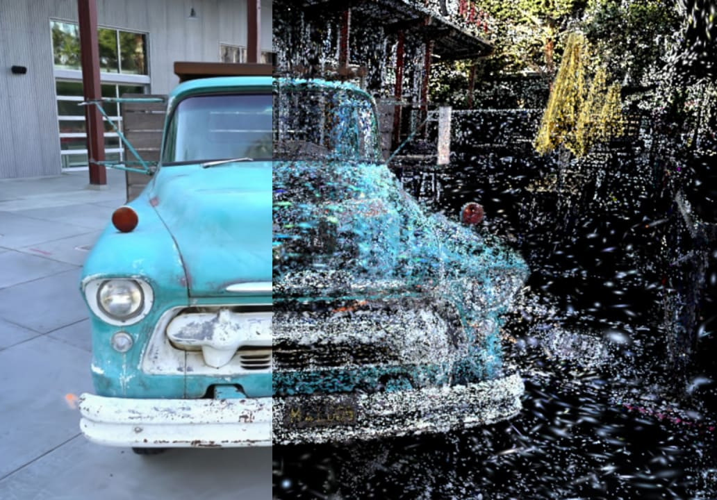
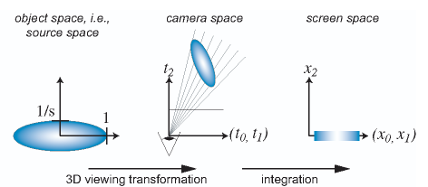
Background
Gaussian Splatting (GS)
Unity Game Engine

Slide 4
Title
Purpose
Improve the integration of Gaussian Splatting (GS) in interactive applications
Goals
Improve a plugin for the Unity game engine that provides useful tools for Gaussian Splats (GS) and correct rendering

Slide 5
Abstract
The project will be focused on improving the use of Gaussian Splats in the Unity Game engine.
There exists Gaussian Splat renderers for the game engine, but they have room to grow in terms of feature and functionality.
These areas of growth include:
Correct multi-splat occlusion
Dynamic shadows
Color grading/correction
4D Gaussian Splatting (Gaussian Splat Video)
Consistent and satisfying UI

Slide 6
User Stories
As a game developer, I want to create stunning and performant games, so that I can create exciting experiences.
As a consumer researcher, I want to show people exactly how a product might look, so that I can efficiently give accurate feedback to product designers.
As an instructor, I want to create interactive trainings that use real world visual information, so that I can provide better training to more people.

Slide 7
Constraints
Visual Fidelity
The true value of Gaussian Splatting lies in its visual fidelity.
Hardware
Gaussian Splatting rendering is currently very inefficient compared to traditional mesh rendering.
Time
There is only so much time to work on this project.

Slide 8
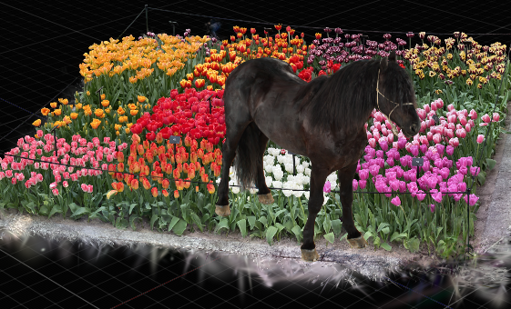
Progress – Multi Splat Occlusion
Before, GS assets would be rendered sequentially on top of each other. Now, the assets are correctly rendered in one step. This required each asset to write into a global graphics buffer.

Slide 9


Slide 10
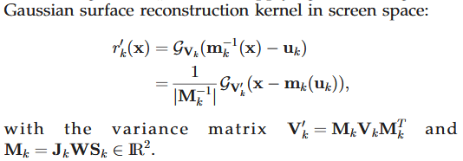
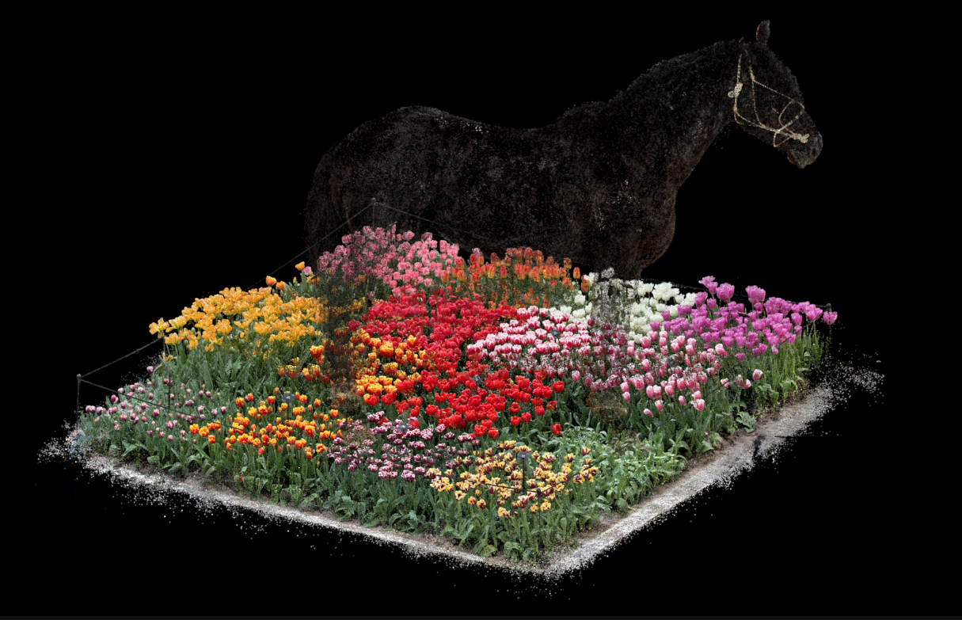
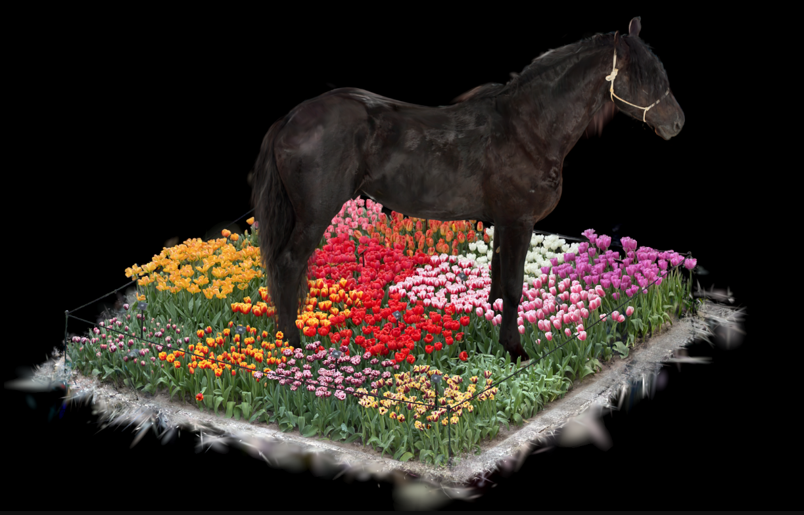
Progress – Isometric Projection
Before, the in the Taylor Series approximation of the projection kernel, the perspective projection Jacobian was always used
Now, if the camera is detected to be isometric the isometric projection Jacobian is used instead.

Slide 11
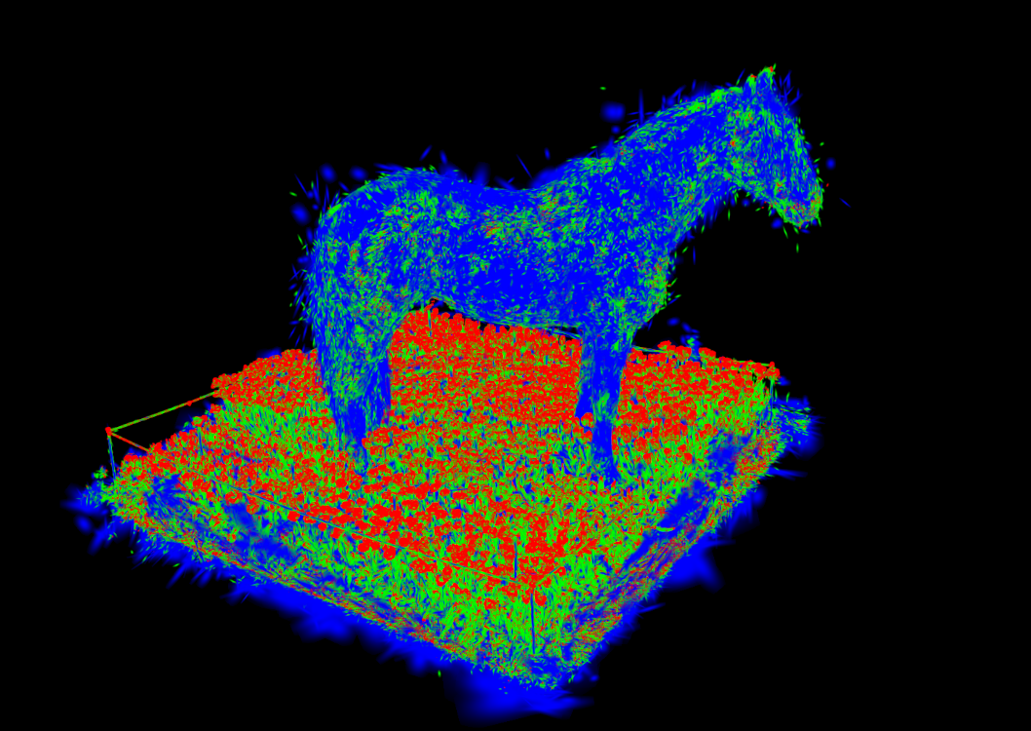
Expected Accomplishments
Complete:
Correct multi-splat occlusion
Isometric projection
Aim to reach one of:
Dynamic shadows
Color grading/correction
4D Gaussian Splatting (Gaussian Splat Video)
LOD rendering

Slide 12
Division of Work
All work is to be done only by Kaleb Wells

Slide 13
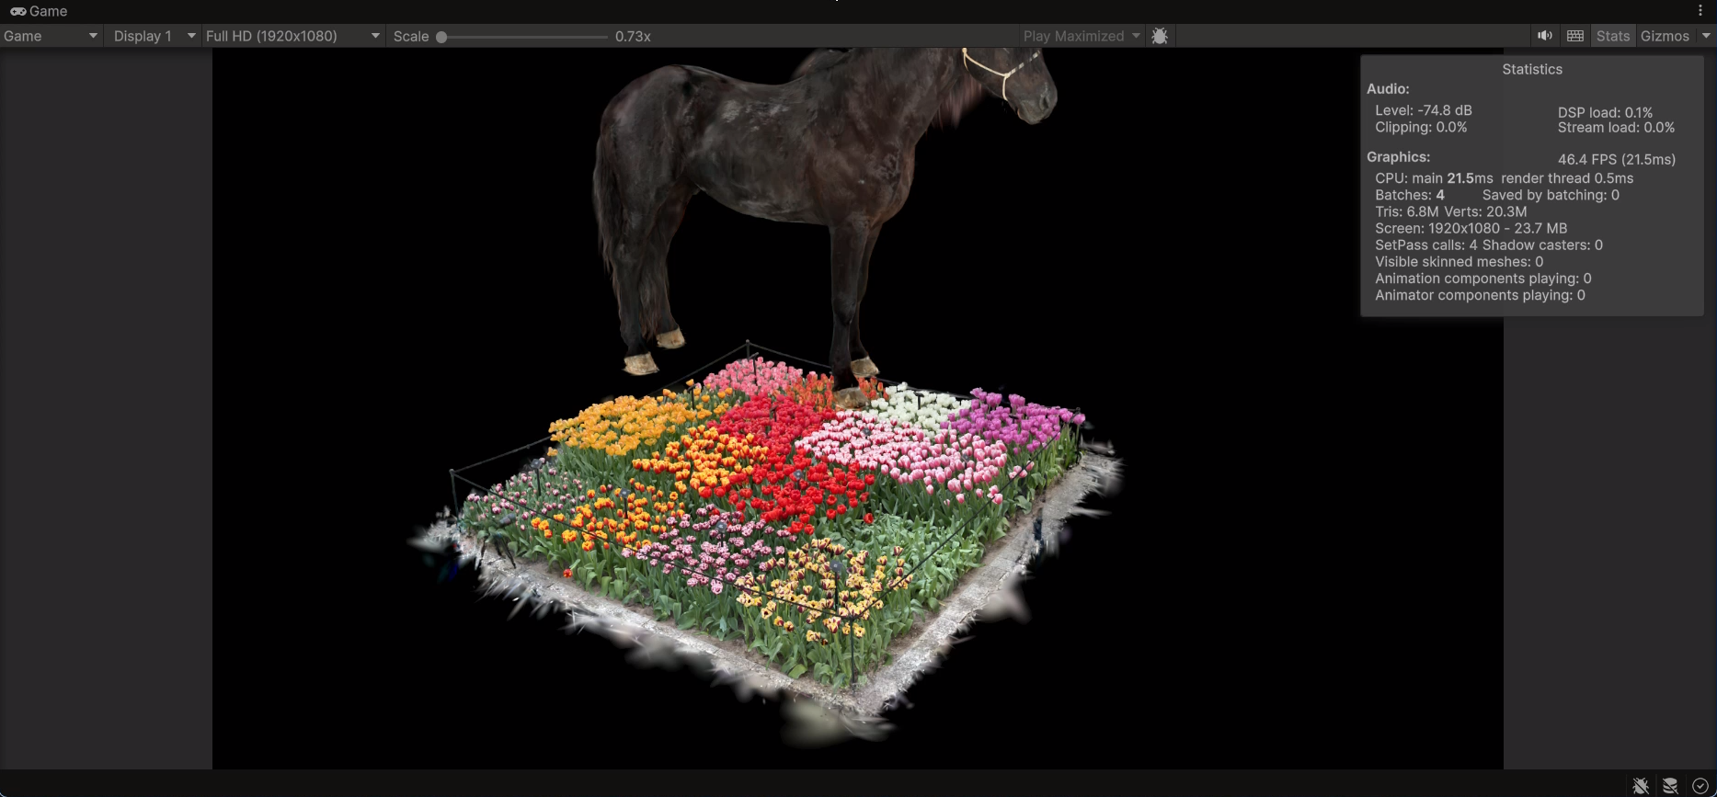
Expected Demo
A real time demo of an interactive application that leverages the capability of this project.

